Slide 1
Lecture 3: Introduction to Machine Learning
12 February 2025

Slide 2
Outline
What is machine learning?
Data analysis approaches
Supervised approaches
Unsupervised approaches
Supervised learning + workshop
Unsupervised learning + workshop
Summary

Slide 3
What is machine learning?
“The field of study that gives computers the ability to learn without being explicitly programmed." (Arthur Samuel)
"A computer program is said to learn from experience E with respect to some class of tasks T and performance measure P, if its performance at tasks in T, as measured by P, improves with experience E." (Tom Mitchell)

Slide 4
Traditional Programming
Machine Learning
Data
Computer
Output
Program
Data
Computer
Model/Program
Output

Slide 5

Terminology
Artificial Intelligence (AI)
Machine Learning (ML)
Deep Learning (DL)

Slide 6
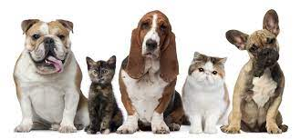
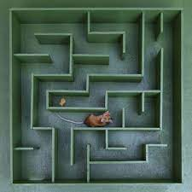
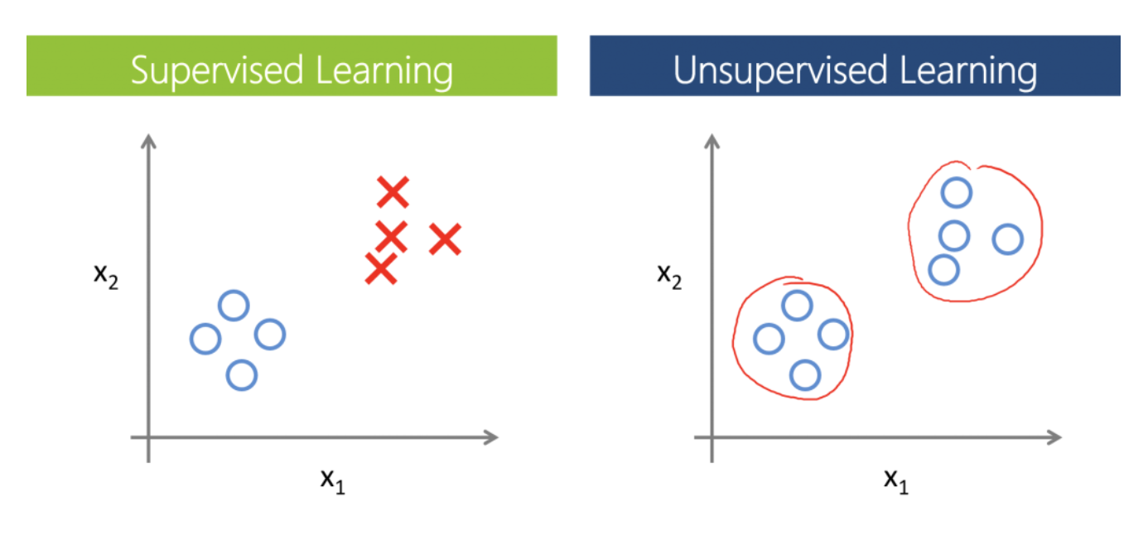

Types of machine learning approaches/problems
Labeled Data
Unlabeled Data
Evaluation of scenarios
D C D C D
Supervised learning
Unsupervised learning
Reinforcement learning
Semi-supervised learning
Differential analysis
Classification & mapping
Object recognition
Standard statistical tests
Clustering
Pattern/feature recognition
Identifying underlying structure
Game playing
Maze solving
Navigation

Slide 7

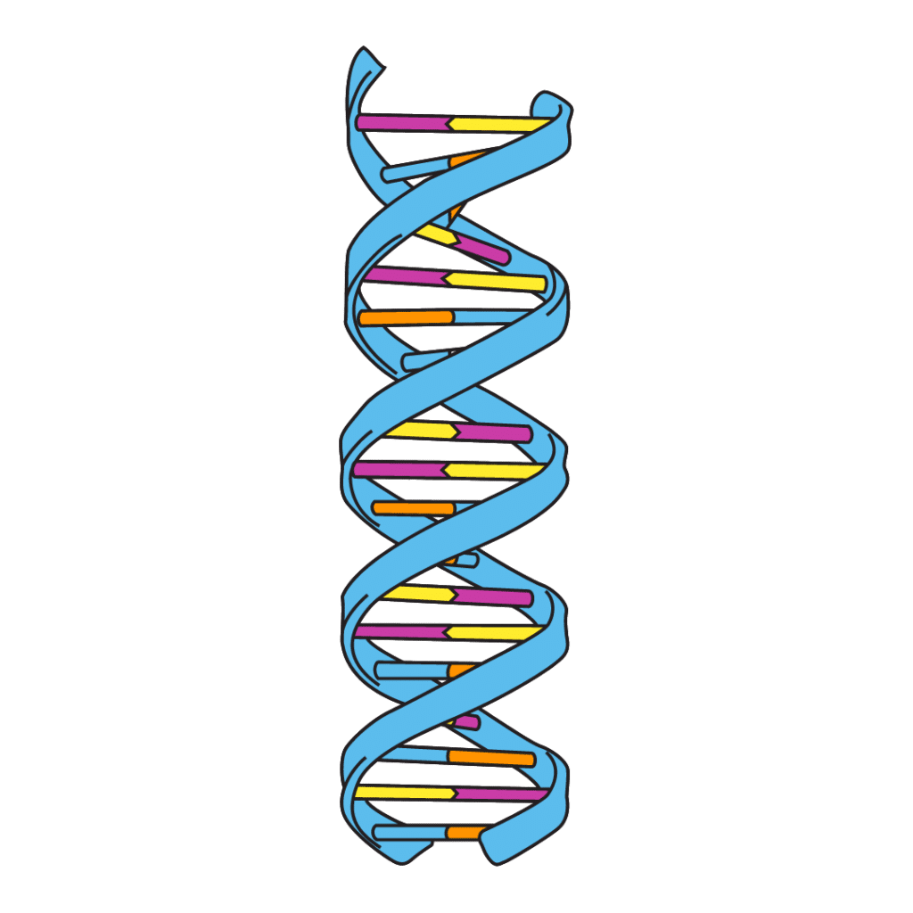
Supervised and unsupervised learning – data sets
Labeled
Unlabeled
Observed objects
D C D C D
Features
Ordered
Unordered
Time series
Genes

Slide 8
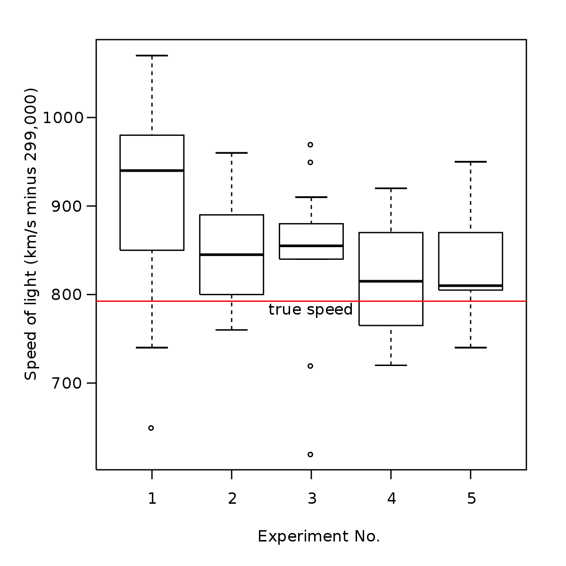
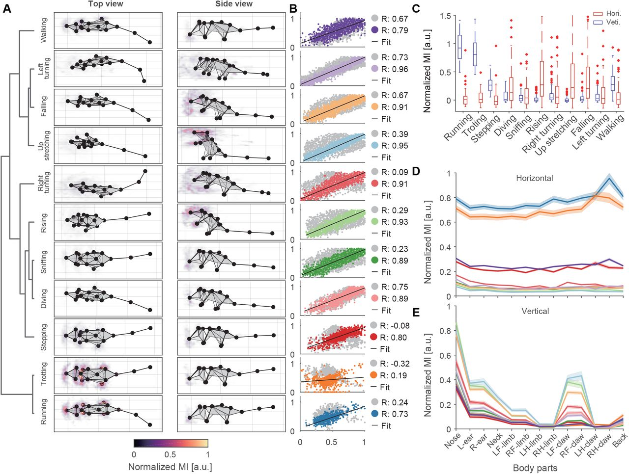
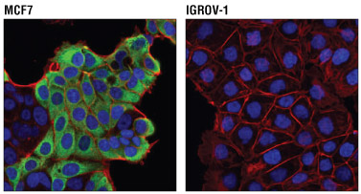
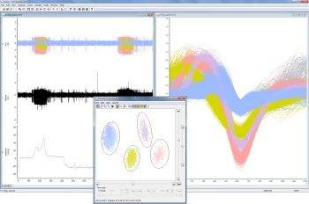
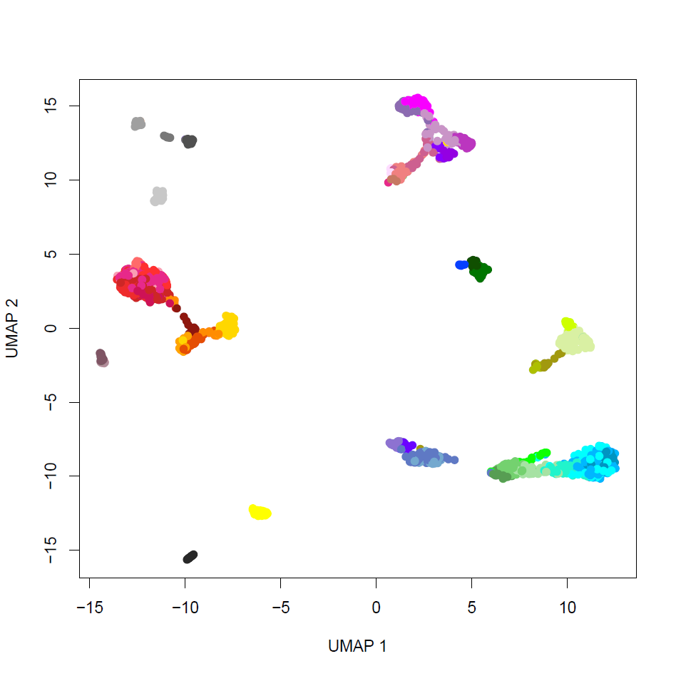
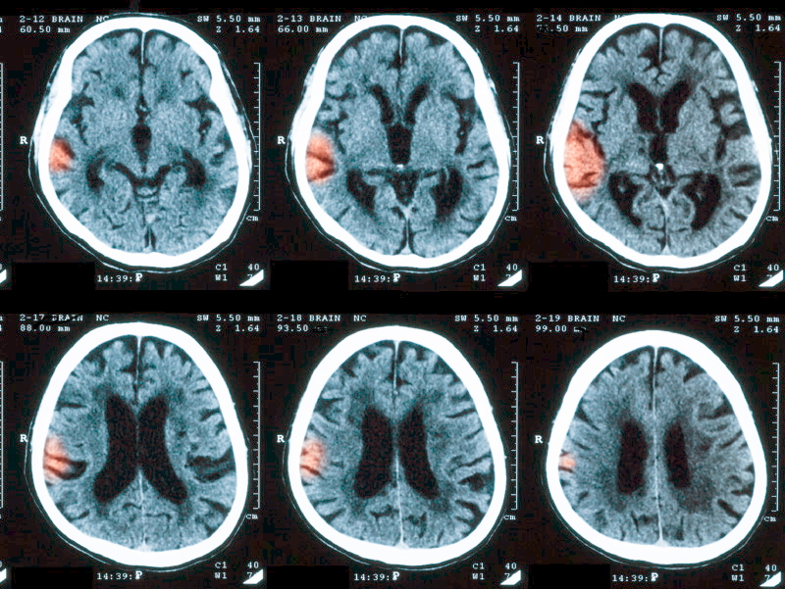
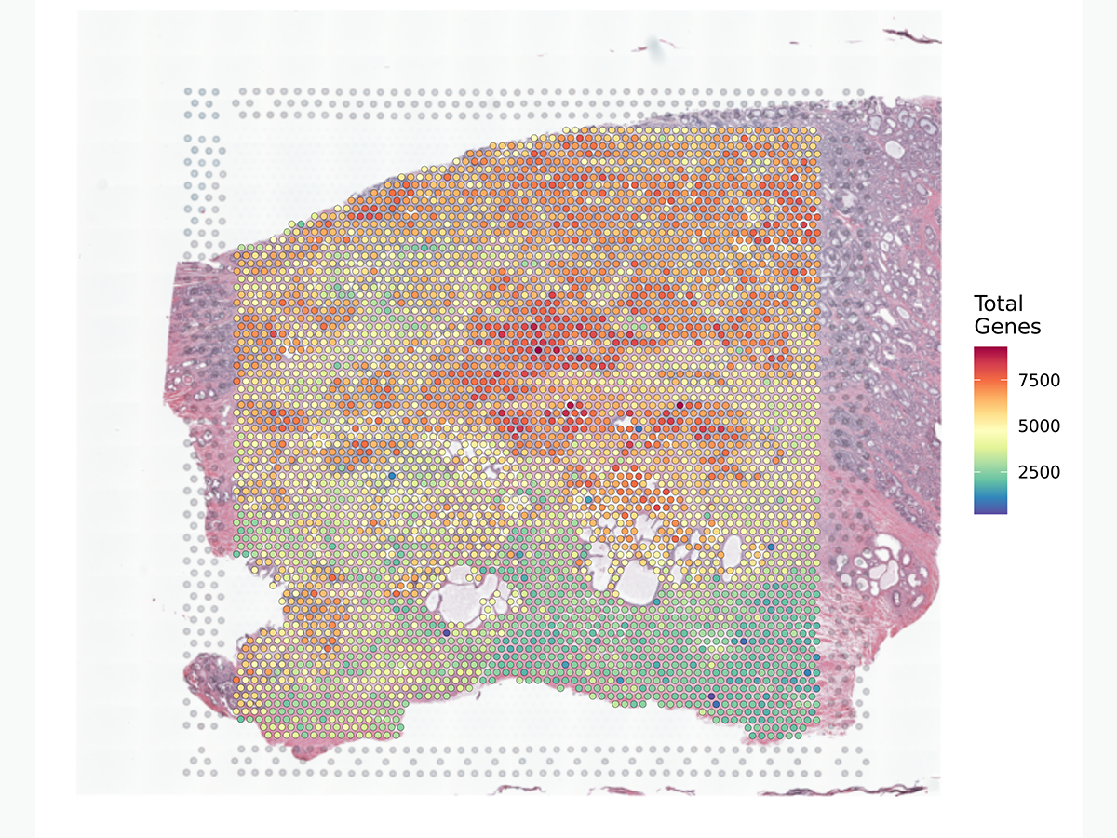
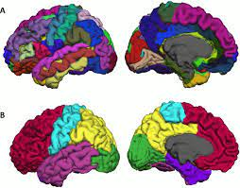
Supervised and unsupervised analysis in neuroscience
Supervised
Unsupervised
Statistical analysis
Behavioral analysis
Image segmentation
Spike sorting
Diagnostics
Transcriptomics
Spatial analysis
Brain parcellation

Slide 9
Types of machine learning approaches/problems
Labeled Data
Unlabeled Data
Evaluation of scenarios
D C D C D
Supervised learning
Unsupervised learning
Reinforcement learning
Differential analysis
Classification & mapping
Object recognition
Standard statistical tests

Slide 10

Supervised analysis: classification
Goal: given a labeled set of training data, classify new objects
D C D C D
Training
Classifier
Classifier
Cat

Slide 11
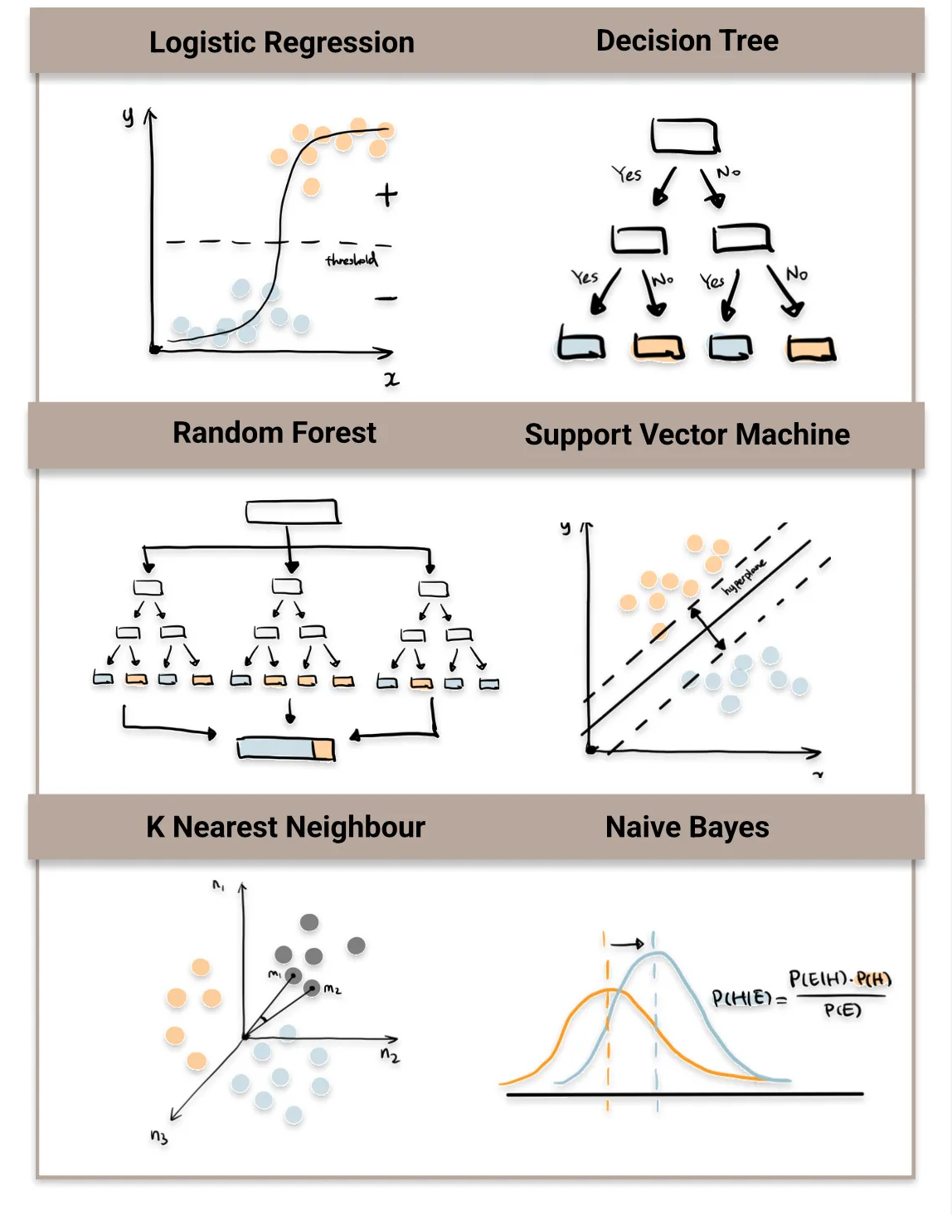
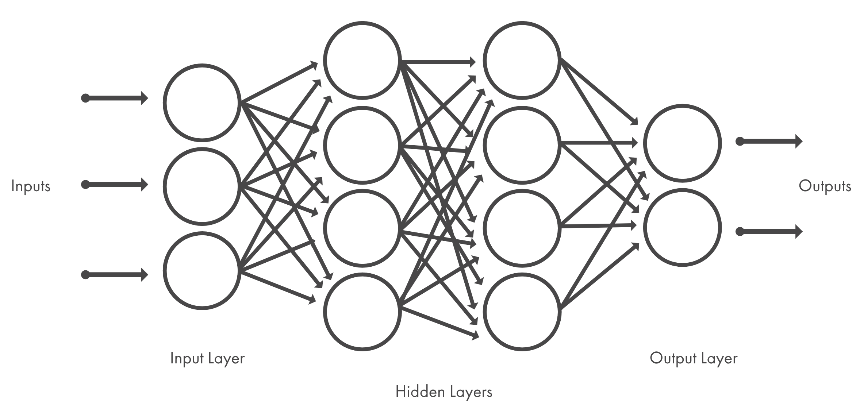
Types of classification algorithms
Neural networks/deep learning
Mathworks (2021)
These methods can also be used to predict continuous variables (regression) rather than categorical classification
Destin Gong (2022)

Slide 12

Overfitting
The #1 danger in supervised algorithms is overfitting:
Classifier does not generalize beyond the training set
How can we avoid overfitting?
1) Reduce the number of parameters (penalize models with more nonzero parameter values)
2) Use a training and holdout (test) set:
If classifier performs poorly on test set, it is likely overfitted

Slide 13
Training, test, and holdout sets
Holdout set: used to evaluate model with final parameter set
Training set: used to fit the model
Test set: used to evaluate model with a specific set of parameters
If models with different parameters are evaluated (using test sets) to find the optimal parameter set

Slide 14
Evaluating models – Confusion matrix
To be applied on the test or holdout set for evaluation
Can be used on training set to assess where the algorithm is struggling
 | Study reports NO difference (Do not reject H₀) | Study reports IS a difference (Reject H₀)
H₀ is true Difference Does NOT exist in population
H_{A} is true Difference DOES exist in population
 | Entities predicted to be in class A | Entities predicted to be in class B
Entities actually belonging to class A | Correct | Incorrect
Entities actually belonging to class B | Incorrect | Correct
Type I Error
Type II Error
Often, the confusion matrix is summarized as total % correct
But always check the full matrix – why?
% correct can be skewed by largest classes

Slide 15
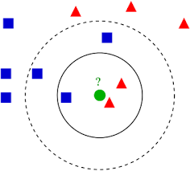
K-Nearest neighbors
Classifies objects based on the most prevalent classes of “nearest” objects
Requires a distance metric (often Euclidean or 1-correlation)
“k” parameter determines the number of nearest objects
Can be unweighted (“majority vote”) or weighted (each vote is weighted by distance)
Deterministic (except for ties)

Slide 16
Types of classification algorithms
Neural networks/deep learning
Mathworks (2021)
These methods can also be used to predict continuous variables (regression) rather than categorical classification
Destin Gong (2022)

Slide 17
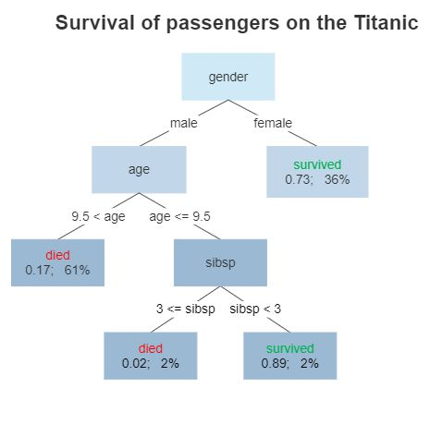
Decision trees & Random Forests
Classifies objects based on a series of “decisions” using the most informative features
For each subdivision, the most informative feature is selected
An individual tree is deterministic
Individual trees tend to be overfitted for more complex data sets

Slide 18
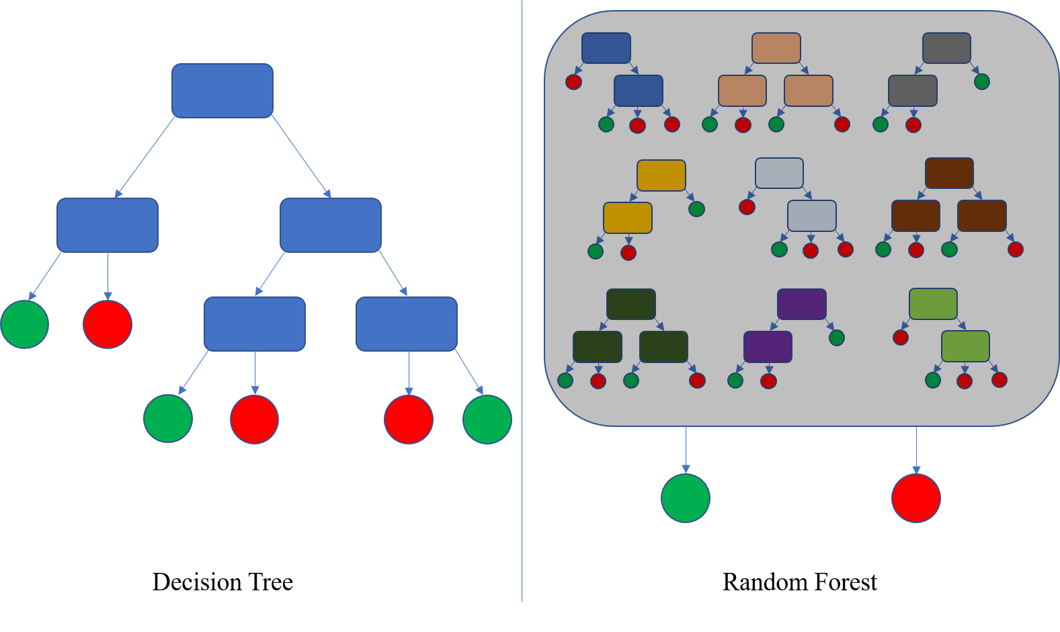
Decision trees & Random Forests
Random forest approaches train multiple trees on subsets of data and features
The votes from these trees are then aggregated
This reduces the danger of overfitting
Not deterministic

Slide 19
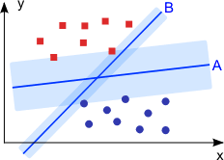

Support Vector Machines
Identifies a line (plane in higher dimensions) that best discriminates different groups of observations
Maximizes the distance between any observation and the discriminant line
Data can be transformed/cast into a different feature space to find an optimal separation (this is a parameter)
Deterministic

Slide 20
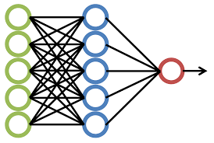
Neural networks & deep learning
Uses brain-like architecture of nodes with connections to learn classification
Each node integrates (weighted sum) its inputs and performs a nonlinear transform for output
Final layer (output node) returns the classification
Pre-defined architecture (# nodes, layers, connections) – lots of parameters, so this requires developing an intuition
Training is achieved by “backpropagating” error to each node and connection; weights are adjusted according to how they contribute to the error
“Weight decay” penalizes large values of weights
Not deterministic (randomized initial weights)

Slide 21
Deep learning packages
Keras (modular, user-friendly, quick)
Easiest to use
Good for smaller runs/prototyping
pyTorch (intuitive, flexible)
R adaptation is called torch in R
Relatively easy to use
tensorFlow (flexible, full control)
Underlies Keras

Slide 22
Reproducibility & randomness
Many machine learning approaches are not deterministic – they involve some degree of randomness
Dividing training data into random subsets
Selecting random subsets of features
Initializing models with random weights
When training a machine learning model that has some aspect of randomness, manually set the random seed to ensure reproducibility

Slide 23
Supervised analysis: recap
Observed objects are labeled
Uses
Differential feature identification
Classification
Object recognition
Keep in mind:
Strategies to avoid overfitting
Randomness and reproducibility
Labeled
Observed objects
D C D C D
Features

Slide 24
Workshop 1: Supervised analysis
Data set: animal attributes

Slide 25
Unsupervised learning
Labeled Data
Unlabeled Data
Evaluation of scenarios
D C D C D
Supervised learning
Unsupervised learning
Reinforcement learning
Clustering
Pattern/feature recognition
Identifying underlying structure

Slide 26
Unsupervised Analysis
No pre-defined grouping among the observed objects
No categories
No labels
Goals:
Uncover underlying structure (let the data “self-organize”)
Discover groupings/relationships among the observed objects
Identify the major modes of variation among the features

Slide 27
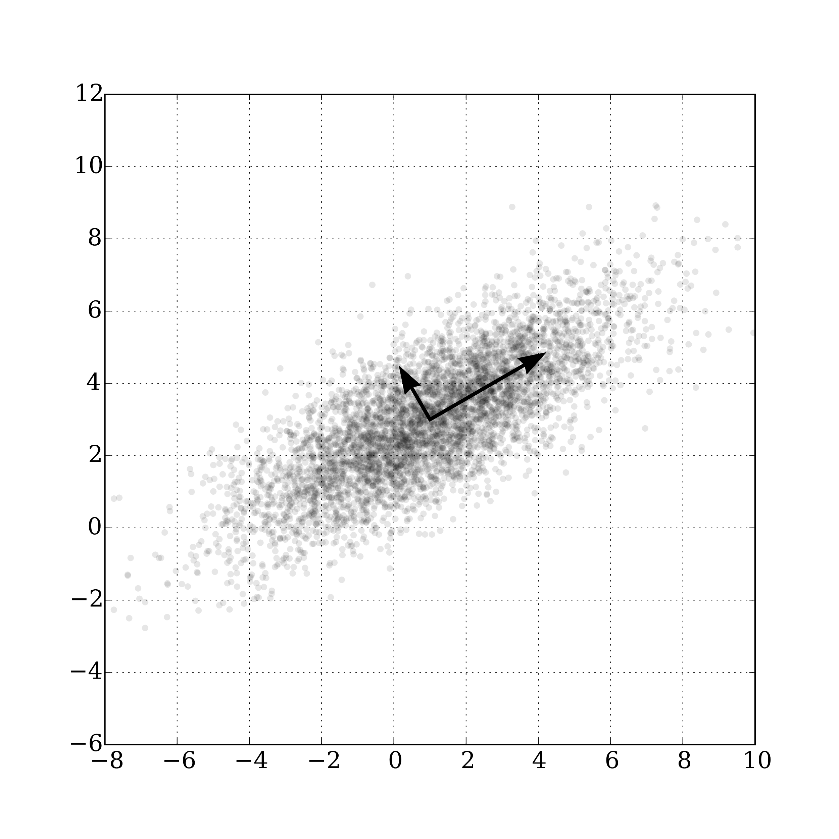
Unsupervised analysis: dimensionality reduction
Features
Mode1
Mode2
“Group” 1
Observed objects
“Group” 2
“Group” 3
One widely used approach uses
Principal Component Analysis (PCA)

Slide 28
Principal Component Analysis
Goal: Identify weighted groups of features that explain the variance in the data
The first principal component (PC) accounts for the largest proportion of variation in the data
Subsequent PCs account for the remaining variance
PCs are (by definition) orthogonal
PCA is deterministic (no randomness)
Dimensionality reduction is achieved by selecting a subset of PCs

Slide 29
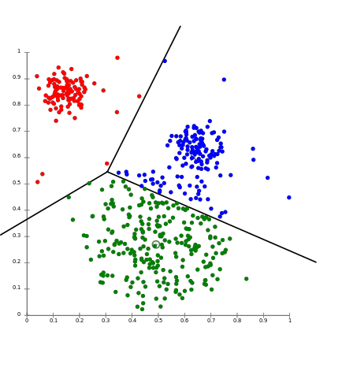
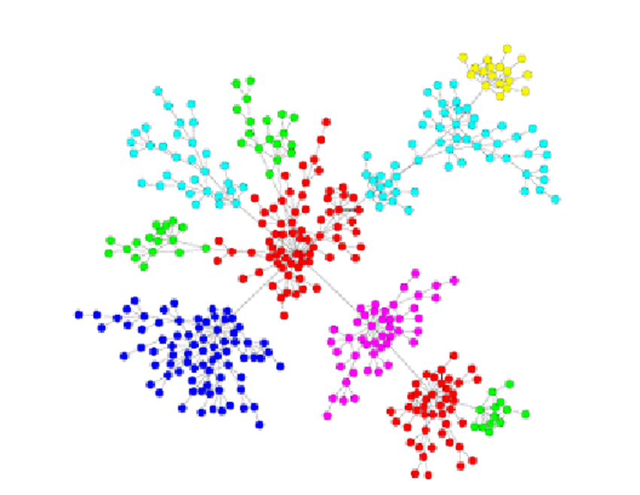
Why perform dimensionality reduction?
Cluster into groups
Characterize relationships
Increase signal-to-noise

Slide 30
Other dimensionality reduction techniques
Clustering of features
Features are aggregated into groups
Independent component analysis (ICA)
Similar to PCA, but no orthogonality requirement
Not deterministic (depends on initial assignment of weights)
Autoencoders (neural network-based)

Slide 31
PCA example: animal attributes
Caveat: there is debate as to whether PCA should be used with binary data. Usually, it still works reasonably well

Slide 32
Examining PCs: proportion of variance
The proportion of variance quantifies how much of the overall variation is explained by each PC
This is used to select the number of PCs to keep for dimensionality reduction

Slide 33
Examining PCs: feature loadings

Slide 34
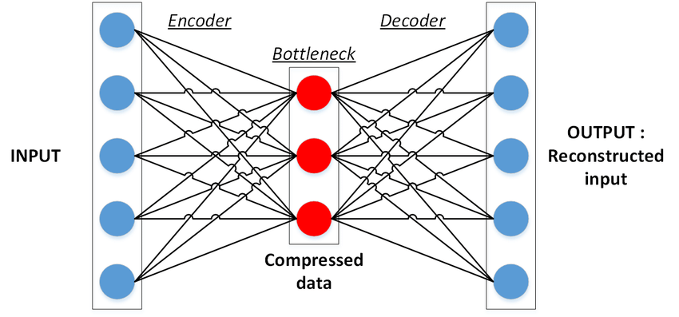
Neural net-based dimensionality reduction: autoencoders
Modification of a supervised neural network
Neural network where the output is optimized to be as similar as possible to the input
Values of intermediate layer nodes then serves as a reduced dimension representation for any given input observation
Sublime & Kalinchieva (2019)

Slide 35
Recap: Dimensionality reduction
Features
Mode1
Mode2
“Group” 1
Observed objects
“Group” 2
“Group” 3
What do we do with this reduced dimension space?
Feature identification
Visualization
Clustering

Slide 36
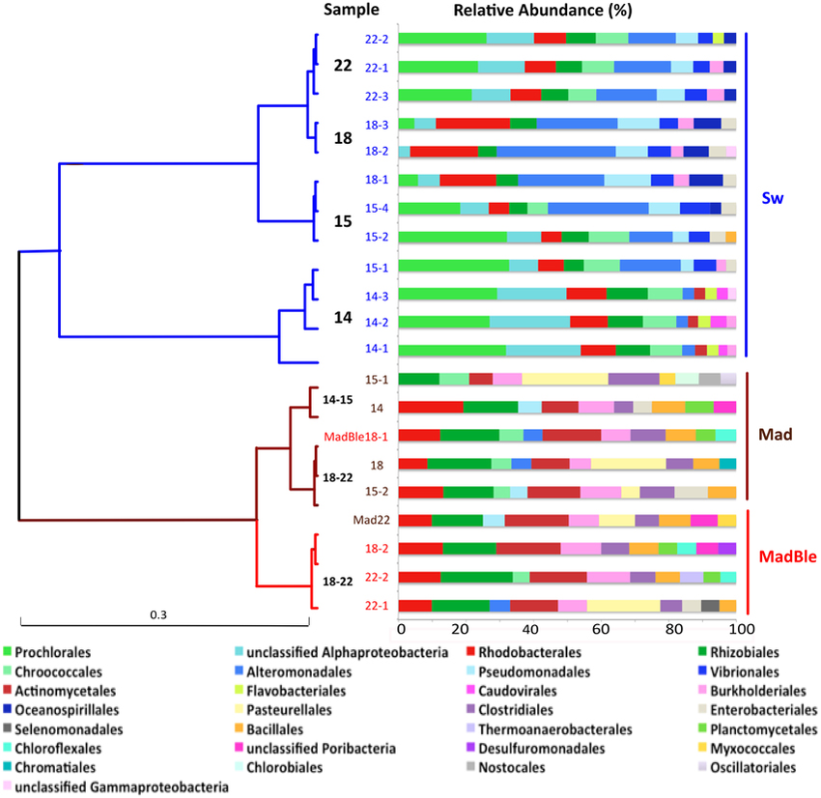
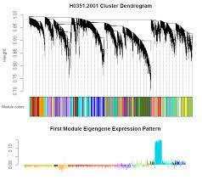
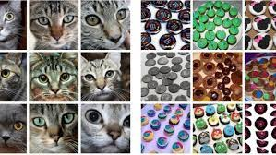
Unsupervised analysis: clustering
Goal: Identify further structure in the data when observations (or features) are not labeled
Metagenomics
Behavioral analysis
Spike sorting
Bulk RNA-seq & proteomics
Single-cell analysis
Image clustering
Functional/structural imaging

Slide 37
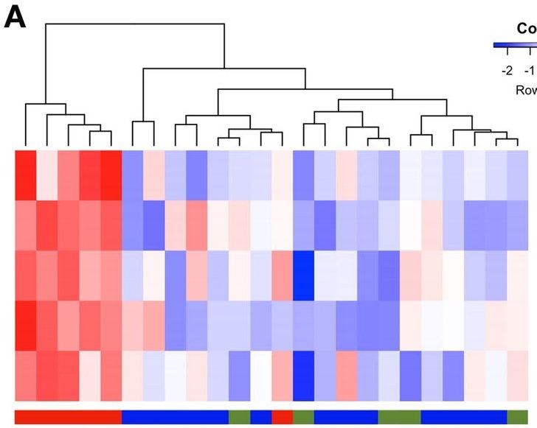
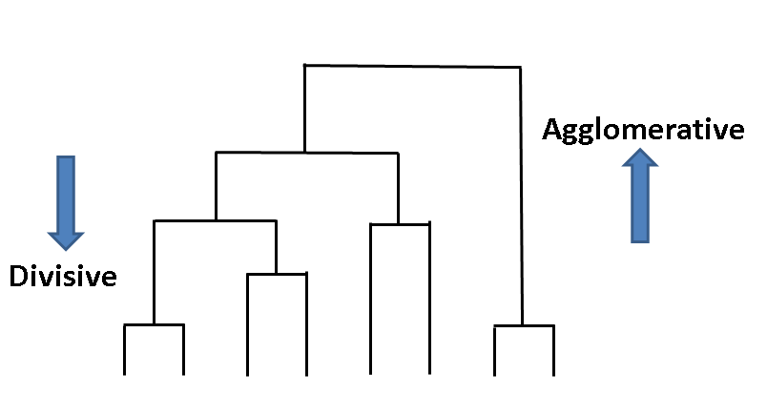
Unsupervised analysis: clustering
Clustering requires:
A distance metric
An algorithm to assign elements to groups
2 major classes: 1) Agglomerative clustering (“building up” of clusters from elements)
2) Divisive clustering (“splitting” data into clusters)

Slide 38
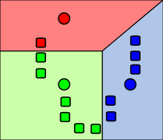
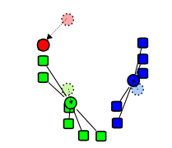
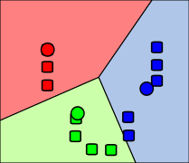
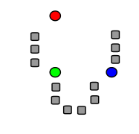
K-means clustering
Select n (pre-specified parameter) random centroids
Associate every data point to its closest mean using the distance metric
Recalculate centroids
Repeat until no changes are made
Initial selection of centroids is random
Number of clusters is pre-specified
Wikipedia.org

Slide 39
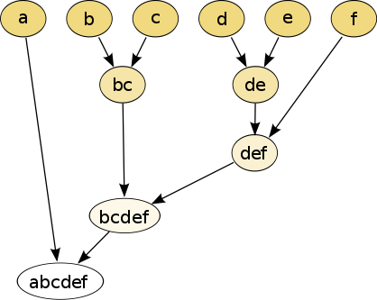
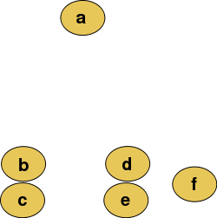
Hierarchical clustering
Using a distance metric, successively group pairs of elements into a tree
After each grouping, recalculate distance metric for new group
Cut the final tree at a specific height to get individual clusters
Wikipedia.org

Slide 40
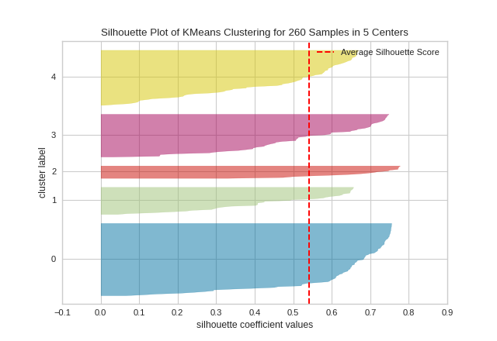
How good is the clustering? How many clusters are there?
Select a given number of clusters and assess separation
Within-cluster distance versus between-cluster distance
Silhouette plots (within-cluster distance compared to “closest” cluster for each point)
Post-hoc classification (supervised learning)
Visualize the data! (Heuristic)
Biological interpretation! (Do the clusters mean anything?)

Slide 41
Unsupervised Analysis - recap
No pre-defined grouping among the observed objects
No categories
No labels
Goals:
Uncover underlying structure (let the data “self-organize”)
Discover groupings/relationships among the observed objects
Identify the major modes of variation among the features

Slide 42
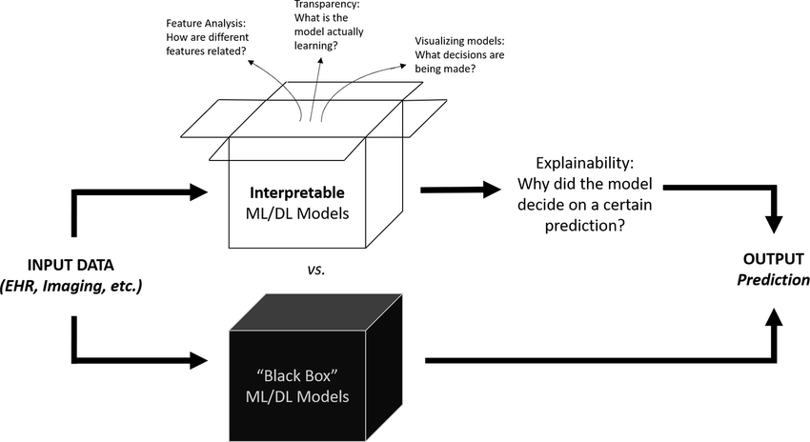
Interpretability of machine learning models
Hui et al. (2021)

Slide 43
Workshop 2: Unsupervised analysis
Data set: animal attributes

